Slide 1

On behalf of the Arctic Domain Awareness Center (ADAC) and the University of Alaska…
ADAC’s Arctic C-ICE March 16-17, 2021
Welcome
to the
2021 Arctic Challenges, Innovations, and Commerce Expo (Arctic C-ICE)

Slide 2
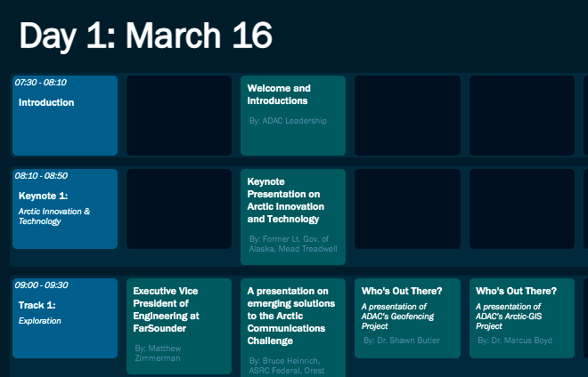
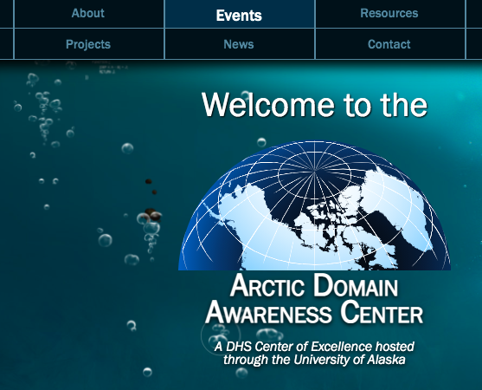

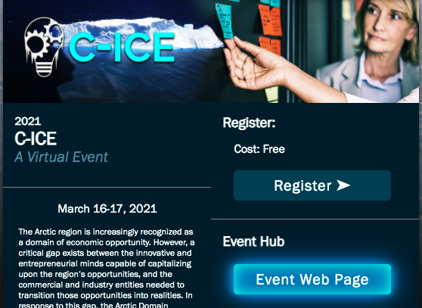
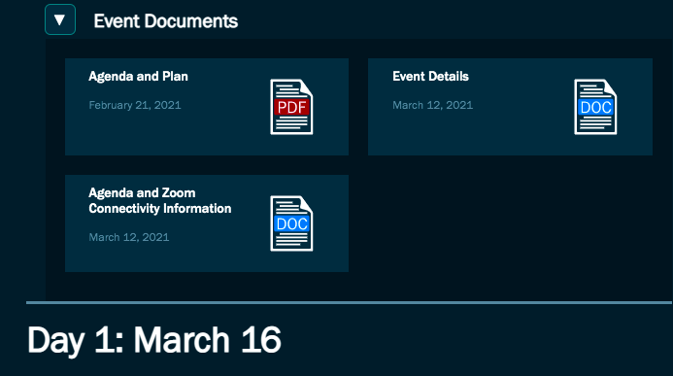
Technical Overview of the Expo
ADAC’s Arctic C-ICE March 16-17, 2021: Day 1
1.
4.
https://arcticdomainawarenesscenter.org
2.
and/or
3.

Slide 3
Live Presentations over in Denali Hall
ADAC’s Arctic C-ICE March 16-17: Day 1
0730-0850 AKDT/1130-1250 EDT
Links at the CICE Event Hub: arcticdomainawarenesscenter.org

Slide 4
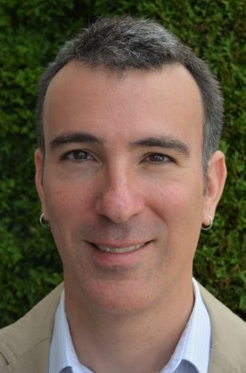
Matthew Zimmerman
Executive Vice President of Engineering
Farsounder
ADAC’s Arctic C-ICE March 16-17: Day 1
0900-0930 AKDT/0100-0130 EDT

Slide 5

R. Isaak Hurst
Founder & Principal Attorney
International Maritime Group
ADAC’s Arctic C-ICE March 16-17: Day 1
0930-1000 AKDT/0130-0210 EDT

Slide 6
Presentations in Denali Hall until 1200 AKDT/0400 EDT
ADAC’s Arctic C-ICE March 16-17: Day 1

Slide 7
Welcome to the
Arctic C-ICE Solutions Showcase
ADAC’s Arctic C-ICE March 16-17: Day 1
1210-1330 AKDT/1610-1730 EDT
Breakout Room 1
ADAC’s Arctic Vessel Monitoring, Geofencing & Alert Awareness Project
Breakout Room 2
ADAC’s Remote Unmanned Aircraft System (UAS) Project
Breakout Room 3
ADAC’s Arctic Maritime Spills Modeling Project
Breakout Room 4
ADAC’s Ice Conditions Index for the Arctic
Breakout Room 5
ADAC’s Marine Induced Polarization Project
Breakout Room 6
ADAC’s Long Range Autonomous Underwater Vehicle (LRAUV) Project
Breakout Room 7
FarSounder
Breakout Room 8
Borrum Energy Solutions Inc.

Slide 8
Thank You

